Slide 1
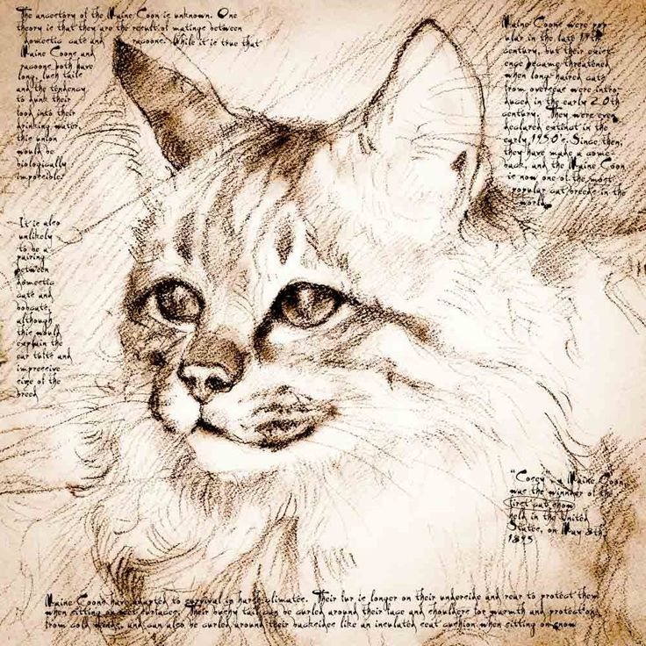
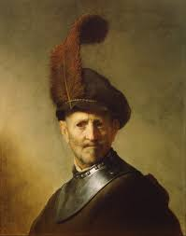
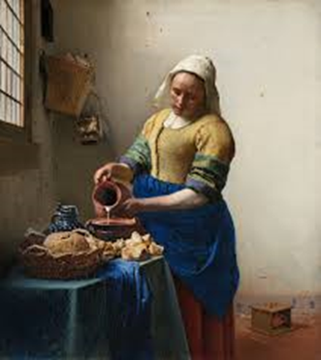
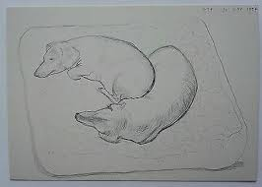
Learning to teach starts with "learning to look": "seeing into" teacher educators’ practices using a Viewing Frame.
(All pictures Wikimedia commons)
David Powell
Notes:
Intro + VF
Activities
What does this mean for ITE curriculum in ...

Slide 2
Aim
To consider how teachers learn to teach and the role of “looking”, “noticing” and interpreting in this process
Outcomes for the session
By the end of the session you will be able to:
Explain the three components of teaching as a practice
State what types of knowledge new teachers need to teach well
State the factors that may shape how you will “learn to teach”
Consider your role as student and teacher in the “learning to teach” process
Reflect on how you have been “learning to teach” so far
Reflect on a teacher educator’s lesson with them

Slide 3
Overview of class
Starter activity
Review the starter activity
Teaching as a practice
Types of knowledge teachers need to teach well
Introduce Viewing Frame and use it for starter activity
Review of my lesson plan
Lecture on learning to teach and learning to look
Activities on looking
Review of class

Slide 4
Starter activity
Please consider and answer the following 7 questions. Thank you.
How many hours of teachers teaching did you “observe” between the ages of 5 and 18?
How many hours of teacher educators’ teaching have you “observed” since you started this course?
Who taught the session before this one today?
What did you notice in it? Why did you notice it?
What did you note down?
What can you remember?
Why am I asking these questions?
Notes:
This activity is normally issued 15 minutes before the scheduled start of the class.

Slide 5
Reflecting on the starter activity
Complete the VF for the review of the starter activity.

Slide 6
Activity on teaching and being a teacher
What does teaching consist of as a practice?
What do new teachers need to know to teach well?

Slide 7
Learning to teach as an initiation into the practice of teaching (Kemmis et al. 2014)
Kemmis et al. (2014) suggest that practices consist of three components:
the sayings, which reflect the ideas and language of the cognitive domain,
the doings, which are the actions of the psychomotor domain,
the relatings of the affective domain.

Slide 8
3 types of knowledge you need to teach
knowledge of students and how they learn;
knowledge of the subject being taught and the curriculum;
knowledge of how to teach the subject and the curriculum.
(Burn, Hagger, and Mutton, 2015)

Slide 9
The lesson plan
Time | Topic / Teaching Activity: teacher educator’s “sayings, doings and relatings” | Student Learning Activity: student teachers’ “sayings, doings and relatings” | Assessment strategy | Theory Underpinning Activity | Resources
09.20 | Display quotation. Distribute lesson plan, viewing frames, [and name cards]. | Prepare for the lesson. Consider quotation. | None | Value-expectancy theory of motivation; Gagne’s 1st level of learning: gaining attention | PP1; Viewing Frame; Viewing Frame for the lesson; lesson plan
09.30 | Introduce self, my study, approach based on seeing through the eyes of our students. Introduce Viewing Frame. Point out lesson plan as another way of “seeing into teacher educators’ practice.” Share the aims, outcomes and overview of the lesson. Explain why I am sharing the aims, outcomes and overview of the lesson. | Listening. Noticing. Turn on teacher educator as student teacher and learner lens | None | Explicit modelling Gagne’s 2nd level of learning: inform students of the objectives; Social Constructivism | PP2-7
Aim To consider how student teachers “learn to teach” and the role of “looking”, “noticing” and interpreting in the process |  | Materials & Resources: PowerPoint slides; Viewing Frame hand out; Viewing Frame for the lesson; lesson plan; wipe board and pens
Objectives/Learning Outcomes State the factors that shape how we “learn to teach” Suggest your role as a student teacher in the “learning to teach” process Reflect on how you are learning to teach so far Reflect on a lesson with a teacher educator Identify strategies that might be adapted for your own teaching
 |  | Evaluation / Assessment: Formative
Links to previous session: None
 |  |  |  |  |  | Week/Session
Course/Class |  | Topic | Learning to teach starts with learning to look | Tutor | David Powell | Date | 19.02.18
 | LESSON PLAN

Slide 10
My teaching as a site for inquiry
“Enacting a pedagogy of teacher education is enmeshed in the ways in which teacher educators knowingly and purposefully create opportunities for students of teaching to see into teaching. It is about how the teacher educators are able to make teaching a site for inquiry. In so doing, students of teaching might see into practice (both their own and that of their teacher educators) in such a way as to gain a genuine appreciation of the skills, knowledge and abilities that shape practice. Such inquiry opens teaching to questioning, probing, reflection and critique that goes way beyond the technical…it is not easy work for either students of teaching or for teacher educators, yet it is fundamental to better understanding and valuing teacher education practices.” (Loughran, 2007, p.1)

Slide 11
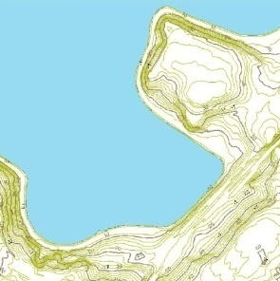
Need for meta-cognition
“Pre-service teachers also should be encouraged to be metacognitive and become aware of how they learn in teacher education courses with the intention of informing their decision-making as they construct their personal pedagogies.”
(Hoban, 1997, cited in Loughran, 2006, p.4)

Slide 12
Munby, Russell and Martin (2001, p.897)
“The overwhelming evidence of a decade of research on teacher knowledge is that knowledge of teaching is acquired and developed by the personal experience of teaching.”
Notes:
This is quite an old quotation, though it is often cited by teacher educators.
The emphasis here seems to be on what is often called the practicum – teaching practice.
Though I’d argue that our trainees’ knowledge of teaching starts before that unless the first thing you do is TP

Slide 13
Boyd (2014, p.65) claims that “Learning to teach” is part of “a complex pedagogy”
Taylor (2008) identified 4 aspects to this:
Cascading expertise;
Enabling students’ individual growth as a teacher;
Developing student teaching;
Student as teacher and learner.
I would add a fifth:
Acquiring the knowledge and language of “learning to teach”
Notes:
Cascading expertise. “This is concerned with teaching students to know about how to teach, with a focus on students acquiring information and practical knowledge. This is achieved through teaching in which information and procedural knowledge is transmitted from expert to novice.” (p.73)
Enabling students’ individual growth as a teacher “…enable individual students to develop certain personal characteristics perceived as relevant to becoming a teacher. Highlighted are self-confidence, enthusiasm, and motivation. Much depends on a student’s ‘personality’, their dedication and altruism as well as their willingness and effort to fulfil the expectations of the expert mentor.” (p.76)
Developing student teaching. “Underlying it is a view that becoming a teacher is a skill learnt through the emulation of experts but adapted by the individual student.” (p.77)
Student as teacher and learner. “Underlying this is a view of learning to teach as enabling students to think critically and originally, question existing practices and explore new principles.” (p.78)
Bi-focal lenses of student and teacher: “as both learner experts and expert learners” (p.79).
I would add a fifth: Acquiring the knowledge and language of “learning to teach”

Slide 14



Teacher of teachers: modelling teaching behaviours
“the practice of intentionally displaying certain teaching behaviour with the aim of promoting student teachers’ professional learning (cf. Gallimore & Tharp, 1992).”
(Lunenberg, Korthagen & Swennen, 2007, p.589).
Notes:
Behaviour based on a knowledge base…t.edors sd be able to make this explicit
Implicit knowledge and ‘practical wisdom’ (Lunenberg and Korthagen, 2009) are in our view not a sufficient foundation of professional behaviour (Lunenberg, Dengerink and Korthagen, 2014, p.6)

Slide 15
A layered pedagogy of teaching education
Teacher educator explicitly models a teaching behaviour and/or value
Student teacher adopts and adapts and models teaching behaviour and/or value in their own practice
Student teacher’s students adopt and adapt behaviour and/or value as they “learn to become…”
Table 11: Boyd’s layered pedagogy of teacher education
(Boyd, 2014, p.70)
Adapted from Boyd (2014, p.70)
Notes:
Metacognition...thinking about how you are learning something
thinkers as our friends (Mycroft and Weatherby, 2014, p.65)

Slide 16

Now let’s apply some meta cognition
What have you noticed in today’s session?
How might I have modelled teaching online to you?
How might you apply these strategies in your online teaching (aka Sarah’s question)?

Slide 17
References and further reading (1/4)
Barthes, R., (2000) Camera Lucida. London: Vintage.
Boyd, P., Using modelling to improve the coherence of initial teacher education: In Boyd, P., Szplit, A., Zbrόg, Z., (2014) Teacher educators and teachers as learners: international perspectives. Libron: Krakόw. pp51-74
Berger, J., (1972) Ways of Seeing. London: Penguin
Burn, K., Hagger, H., Mutton, T., (2015) Beginning teachers’ learning: making experience count. Northwich: Critical Publishing
Britton, B., Glynn, S., and Smith, J. (1985) Cognitive demands of processing expository text: a cognitive workbench model. In: Britton, B.K. and Black, J.B. eds. Understanding expository text: a theoretical and practical handbook for analyzing explanatory text. London: Laurence Erlbaum Associates, pp.227-248.
Cordingley, P., (2013) Research and teacher education: The BERA-RSA Inquiry. The contribution of research to treachers’ professional learning and development. December 2013. BERA.
Gelb, H., (2004) How to think like Leonardo da Vinci: seven steps to genius every day. New York: Delta Trade Paperbacks

Slide 18
References (2/4)
Hockney (2014) Directed by Randall Wright. UK: Channel 4 Films
Hockney, D., Gayford, M., (2016) A history of pictures. London: Thames & Hudson
Hockney, D. 1988. A retrospective. New York: Metropolitan Museum of Art.
Hogg, L., and Yates, A., (2013) Walking the Talk in Initial Teacher Education: Making Teacher Educator Modeling Effective, Studying Teacher Education: A journal of self-study of teacher education practices, 9 (3), pp311-328
Kemmis, S., Wilkinson, J., Edwards-Groves, C., Hardy, I., Grootenboer, P., and Bristol, L. (2014a) Changing practices, changing education. London: Springer.
Lortie, D. (1975) Schoolteacher: a sociological study, Chicago, IL, The University of Chicago Press
Loughran, J. and Berry, A. (2005) Modelling by teacher educators. Teaching and Teacher Education, 21, (2) pp.193-203.

Slide 19
References (3/4)
Loughran, J., (2007) Enacting a pedagogy of teacher education. In: Russell, T., and Loughran, J., Enacting a pedagogy of teacher education: values, relationships and practices. Abingdon: Routledge. pp1-15.
Lunenberg, M. and Korthagen, F., (2009): Experience, theory, and practical wisdom in teaching and teacher education, Teachers and Teaching, 15 (2), pp 225-240
Mason, J. (2002). Researching your practice: the discipline of noticing. London: RoutledgeFalmer
Munby, H., and Russell, T., (1994) The authority of experience in learning to teach: messages from a physics methods class, Journal of Teacher Education, Vol. 45, No. 2, March/April 1994, pp. 86-95

Slide 20
References (4/4)
Powell, D., (2016) It’s not as straightforward as it sounds”: An action research study of a team of further education-based teacher educators and their use of modelling during a period of de-regulation and austerity. Unpublished EdD. Huddersfield: University of Huddersfield.
Star, J., and Strickland, J., (2008) Learning to observe: using video to improve preservice mathematics teachers’ ability to notice. Journal of Mathematics Teacher Education. Vol 11. pp107-125
Sweller, J., Ayres, P., Kalyuga, S., (2011) Cognitive Load Theory. New York Dordrecht Heidelberg London: Springer
Taylor, A. (2008) Developing understanding about learning to teach in a university-schools partnership in England, British Educational Research Journal, 34, (1) pp.63-90.
Watson, G., (2017) Attention: beyond mindfulness. London: Reaktion books
Wood, E. and Geddis, A. (1999) Self-conscious narrative and teacher education: representing practice in professional course work. Teaching and Teacher Education, 15, pp.107-119.

